Slide 1
to the Reception classes at Park Street
We are very happy that you have chosen to join us next year and can’t wait to meet you all.
Now lets meet the teachers….

Slide 2
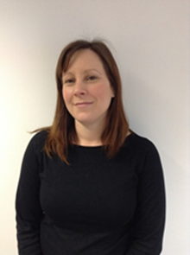
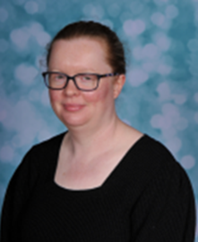
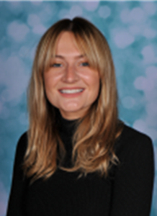
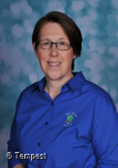
Hello from Mrs Watson, Miss Clementson Miss Hodgson and Mrs Stevens
I am a teacher in class Wednesdays, Thursdays and Fridays
I am a teacher in class Mondays, Tuesdays and Wednesdays
I am a teaching assistant in class all week.
I am a teaching assistant in class all week.

Slide 3
We are very excited to have all you lovely children in our classes next year and have lots of ideas about all the fun learning you are going to be doing with us next year.
We can’t wait!!!!

Slide 4
This is how we organise our curriculum in Reception. We teach through topics and use stories as a stimulus for our weekly learning theme.
2022-23 termly themes
Autumn 1 - Marvellous Me! Focus on families, friends, and getting to know each other and our individuality.
Autumn 2 - Sparkle and Shine Focus on celebrating winter festivals.
Spring 1 - Magical Storyland Focus on story language, learning traditional stories and acting them out and retelling them in own words.
Spring 2 - Amazing Animals Focus on different habitats, and the animals that live there.
Summer 1 - Watch it grow Focus on life cycles of plants and animals and seasonal changes.
Summer 2 - Off we go! Focus on journeys, places we have been and would like to go, how we get there. Preparing for our transition into Year 1.

Slide 5
The Early Years Areas of Development
Understanding the World
Past and Present
People and Communities
The Natural World
Expresive Art
and Design
Creating with Materials
Being Imaginative and Expressive
Physical Development
Gross Motor Skills
Fine Motor Skills
Each week activities are planned to support these areas of development.
Personal, Social and Emotional Development
Self Regulation
Managing Self
Building Relationships
Mathematics
Number
Numerical Patterns
Communication and Language
Listening, Attention and Understanding
Speaking
Literacy
Comprehension
Word Reading
Writing

Slide 6
A typical day in Reception Class
8.30am -We start the day with a morning activity such as sharing books, singing, dough disco or practising writing names.
9am - When all the children have arrived and water bottles and lunch boxes are put away, then we begin register.
Next we introduce our learning for the day.
We do our daily phonics groups, then outdoor or indoor play in our continuous provision. Snack time at 10am then a story session and literacy class input. More play based learning in the classroom and outdoor provision before tidying, washing hands and lining up for lunch at 11.45am.
Teachers support children in the hall until 12pm when the lunchtime supervisors arrive.
1pm – Register and then whole class Maths learning before play based learning in the classroom and outdoor provision.
2.45 pm- tidy-time, story time and good byes for the end of the day.

Slide 7
Continuous Provision
Children learn best through play and so we have areas of the classroom that we call Continuous provision that have resources that allow the children to explore, create, investigate and challenge themselves as well as sharing and cooperating with other children.
These areas have some resources that remain though out the year to allow children to return to a favourite resource and activity. They also get enhanced with different resources that link to a weekly theme. An example of an enhancement would be ice cubes in the water area, Christmas decoration in the role-play area or books about mini-beasts in the reading area.

Slide 8
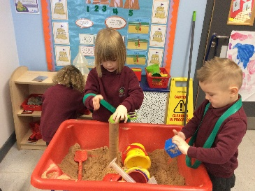
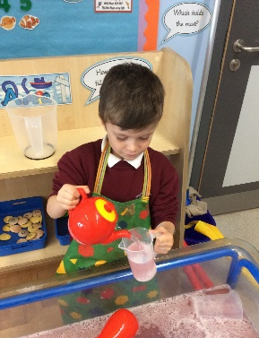
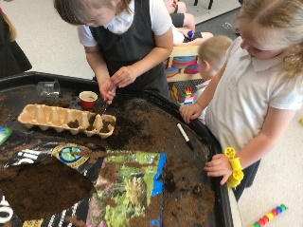
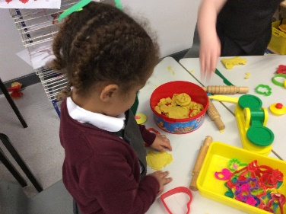
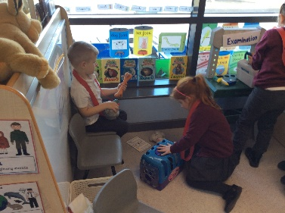
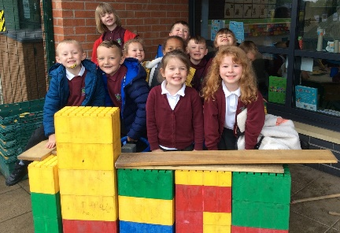
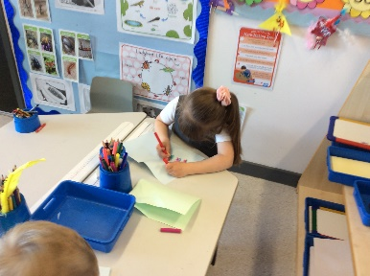
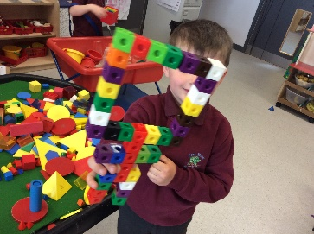
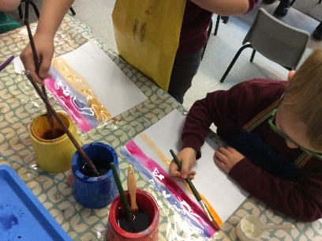
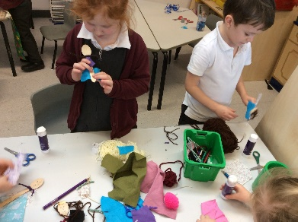
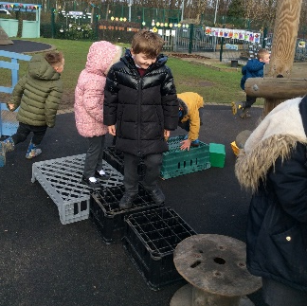
Investigation
Area
Sand Area
Water Area
Malleable Area
Reading Area
Role-play Area
Construction Area
Continuous Provision
Writing Area
Maths Area
Painting Area
Creative Area
Gross Motor skills

Slide 9
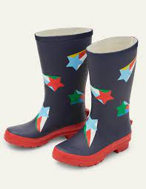
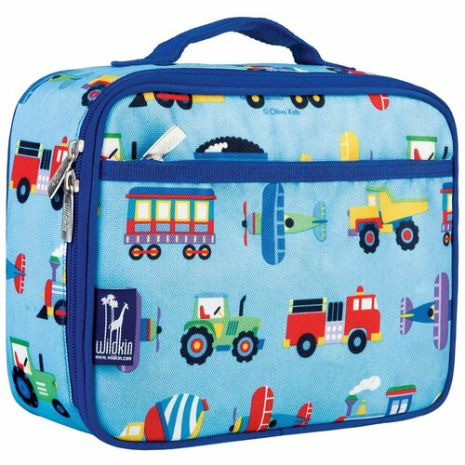
Things you will need each day
wellies – Welly walk on Wednesdays each week and mud kitchen can be used daily.
water bottle
coat
Lunchbox- if you are not having a school dinner ( these are free for Infants)
Book bag - reading diary and reading book

Slide 10
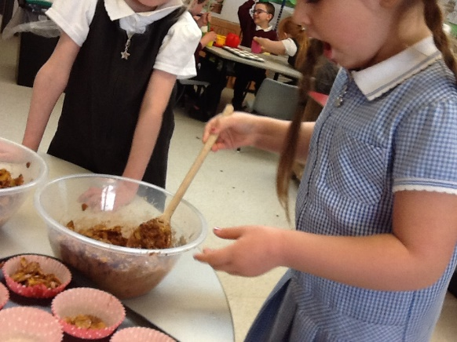
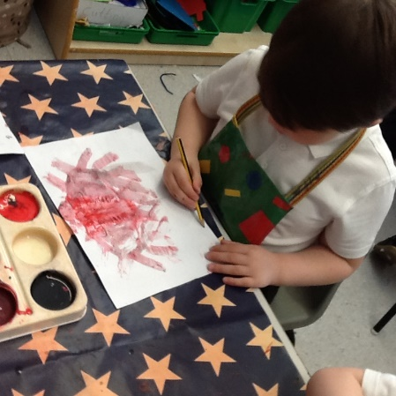
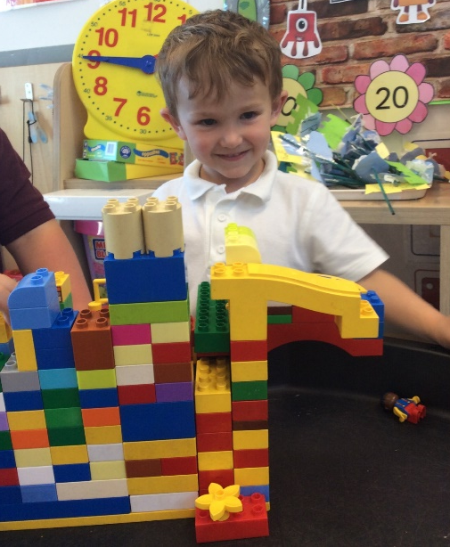
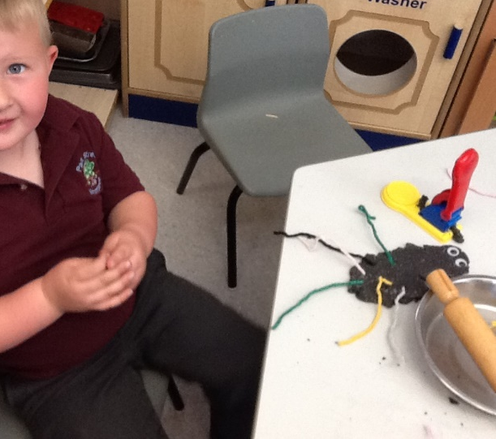
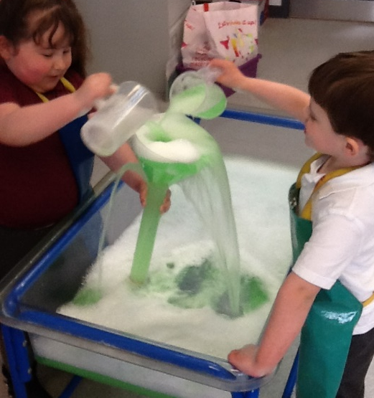
We are going to be doing lots of this:-
and this
and this
and this!!!!

Slide 11
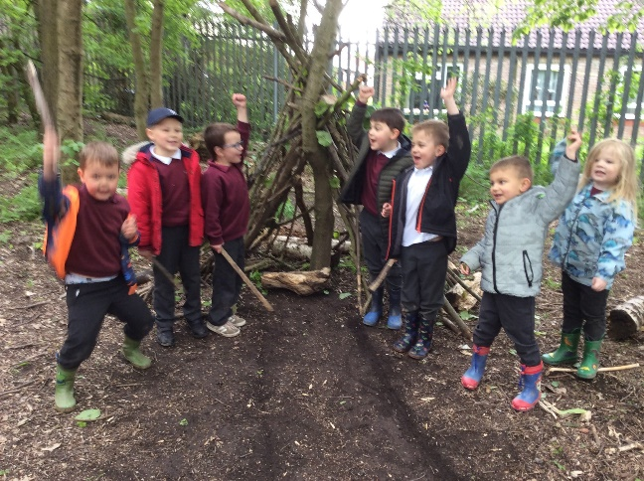
We are going to be reading lots of stories.
We are going to be going on Welly walks.
We are going to be playing lots of games and keeping active outdoors.

Slide 12
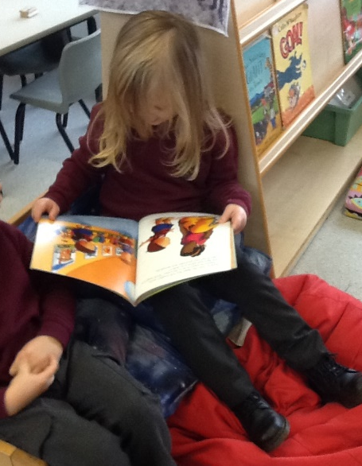
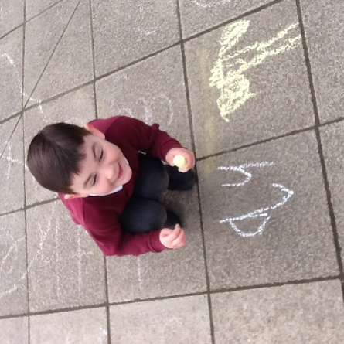
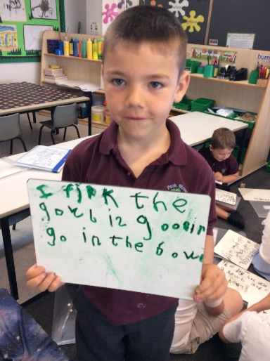
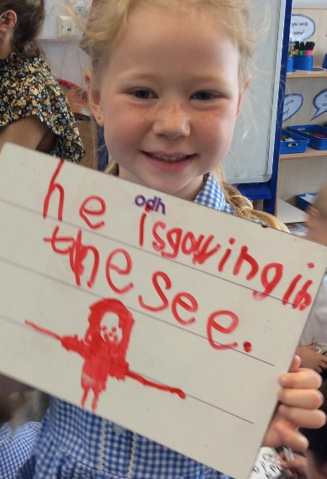
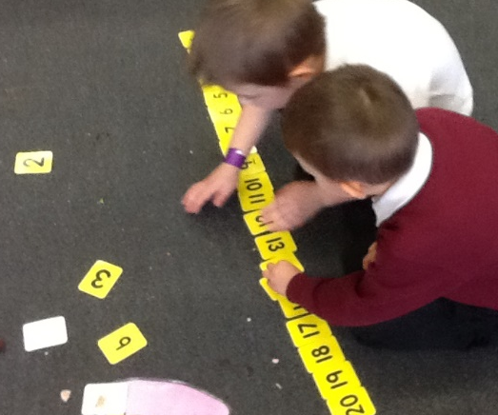
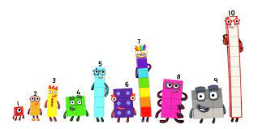
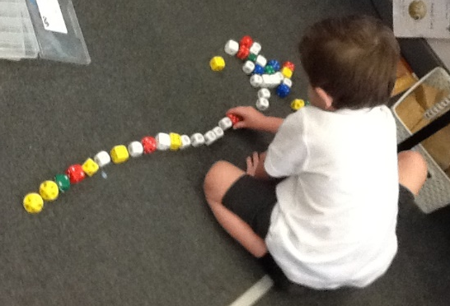
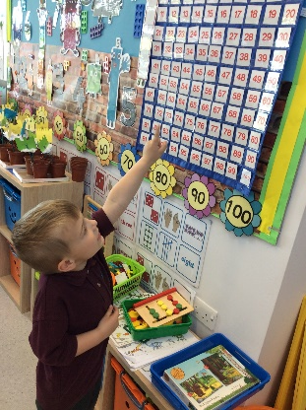
We will be helping you to learn to read and write by doing phonics every day.
We will be helping you develop your understanding of numbers everyday.

Slide 13
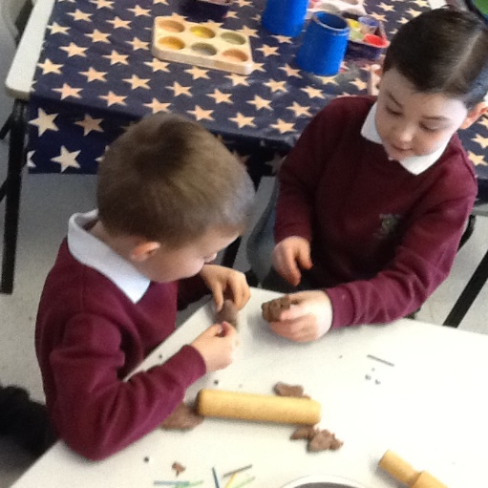
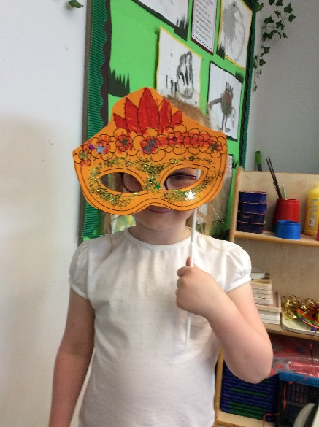
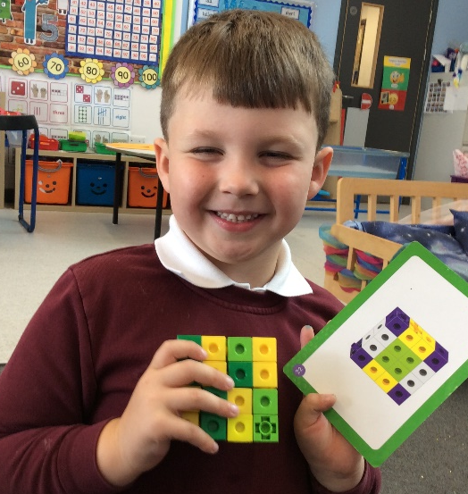
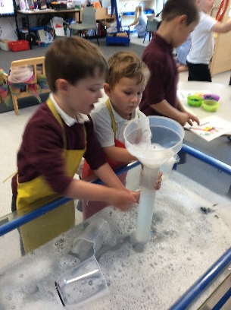
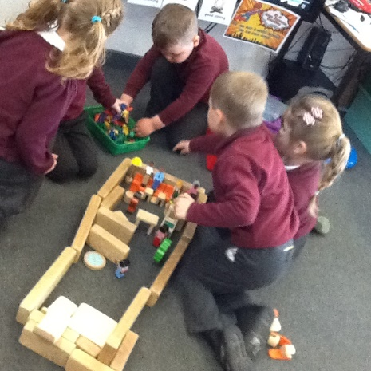
and most important of all you will be learning through play in the different areas of our classrooms and learning to share, take turns and make friends whilst you are doing this.
Doesn’t this sound like lots of fun!!!!!!

Slide 14
We can’t wait to meet you and for you to start your learning journey with us at Park Street.

